Slide 1

TELEPHONE DIRECTORY
SAMUDRALA YASHWANTH AM.EN.U4AIE20063

Slide 2
introduction
telephone directory system in java, task is to save the contact information of the favored people in a database. it's far a pleasant clean to use interface developed in Java, because the returned cease to store the info. This software shops all of the details like call, cell phone wide variety, address, electronic mail identification and internet site in a database. This device was developed to reduce the errors that go wrong in manual structures. It turned into very difficult to keep all of the details manually there this kind of gadget become evolved.

Slide 3
This software also lets in to edit, update and search numerous touch info. it's far new, different and easy to use and reliable software program system. It additionally gives an excellent degree of safety as there's an admin who can most effective edit and update details. in advance wherein there was best a manual machine which required loads of office work however now an automated machine is evolved which meet all of the necessities. that is phonebook application in java.

Slide 4


OVERVIEW
Telephone directory is a daily needed tool in order to communicate with others.
It is commonly installed in mobile phones etc.
It helps in viewing, deleting, adding and searching the details of a person easily.
In this the details of the people are stored in the form of binary tree And radix sort is used to sort the names in aplhabetical order to make the search easy.

Slide 5
Radix sort
Radix sort sorts items by grouping them into buckets according to their radix. This makes radix sort ideal for sorting items that can be ordered based on their component digits or letters, such as integers, words, etc.
Radix sort is a non-comparative sorting algorithm that is better than the comparative sorting algorithms. It has linear time complexity that is better than the comparative algorithms with complexity O(n logn).

Slide 6
PROCESS
The process of running the code is, first a file will be imported with all the contact details present.
Later we can perform the actions of our choice which are available in the telephone directory.
Then, the results are shown in the output.

Slide 7
Implementation
Implemented Binary Tree for storing the contact details
Implemented radix sort for sorting the contacts alphabetically.
Implemented many functions and methods like, string tokenizer, getRoot(), getleft() , etc.

Slide 8
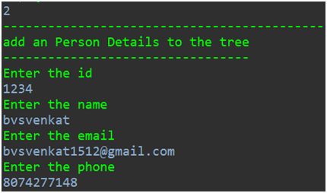
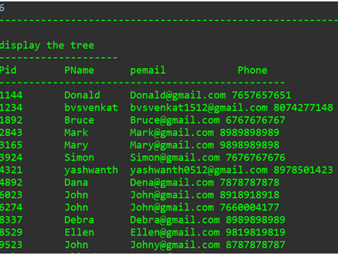
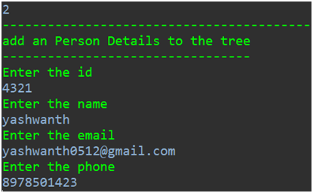
Implementation
adding new contacts to the system

Slide 9
Thank you!

